Slide 1
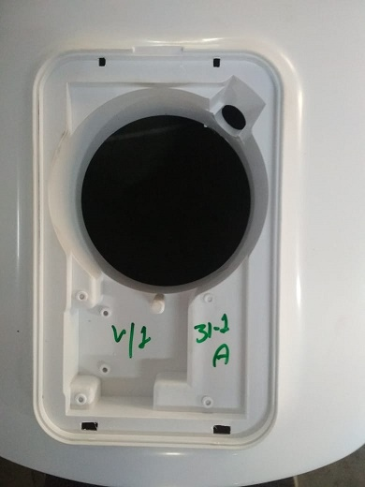
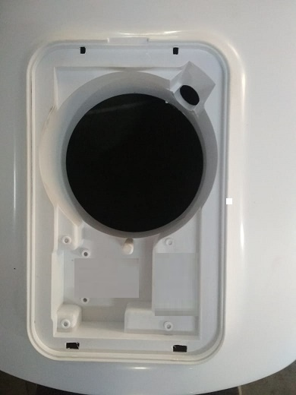
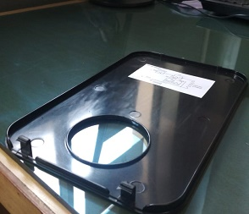
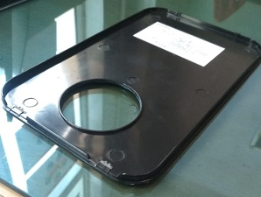
Kaizen
Dept./Section : Storage water heater/D-316 Onkar
Process : Tool Room
Date of implementation : 24.01.2020
Improvement categories (Tick the applicable one’s) :
(1) Quality imp.
(2) Manpower/Man hours
(3) Reduce 3M
(4) Space saving
(5) Time saving
(6) Energy Saving
(7) Tact
(8) Yield
(9) 5S
(10) Efficiency
(11) Material Saving
(12) Waste Reduction
(13) Packing
(14) Safety
(15) Others
Before
After
Deco plate Broken during assembly with Top
Window correction in Mould
Benefits:
1- Productivity improvement .
2- Minimize Rejection of Deco plate
3- Easy to Assembled

Slide 2
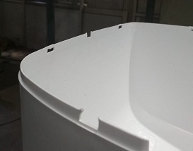
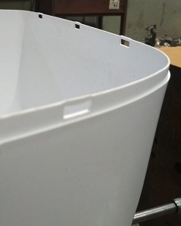
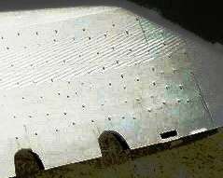
Kaizen
Dept./Section : Storage water heater/ D-316 Onkar
Process : Tool Room
Date of implementation : 16-01-2020
Improvement categories (Tick the applicable one’s) :
(1) Quality imp.
(2) Manpower/Man hours
(3) Reduce 3M
(4) Space saving
(5) Time saving
(6) Energy Saving
(7) Tact
(8) Yield
(9) 5S
(10) Efficiency
(11) Material Saving
(12) Waste Reduction
(13) Packing
(14) Safety
(15) Others
Before
After
Short Molding of Lock in Qube Top Cover
Provided catcher punching in mold
Benefits:
1- Rejection Minimized
2- Proper Assembly of Top & Bottom

Slide 3
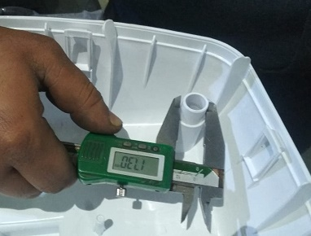
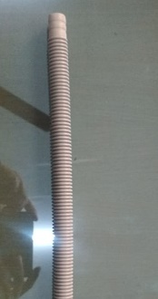
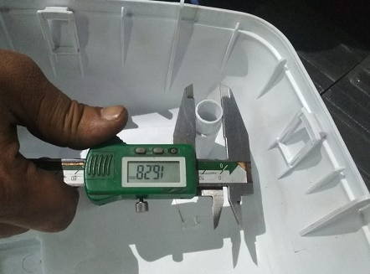
Kaizen
Dept./Section : Storage water heater/ D- 316 Onkar
Process : Tool Room
Date of implementation : 27-01-2020
Improvement categories (Tick the applicable one’s) :
(1) Quality imp.
(2) Manpower/Man hours
(3) Reduce 3M
(4) Space saving
(5) Time saving
(6) Energy Saving
(7) Tact
(8) Yield
(9) 5S
(10) Efficiency
(11) Material Saving
(12) Waste Reduction
(13) Packing
(14) Safety
(15) Others
Before
After
Different OD of Power Cord Flexible Pipe Pocket in 15 & 25 Qube
Common OD of Power Cord Flexible Pipe Pocket in 15 & 25 Qube
Benefits:
1- Minimized Scrap qty due to Flexible pipe comes out after PUF pouring.
2- Inventory control due to common items.
3- No chance of wrong Flexible pipe assembly
Prepared By:-
Reviewed By:-
Approved By:-

Slide 4
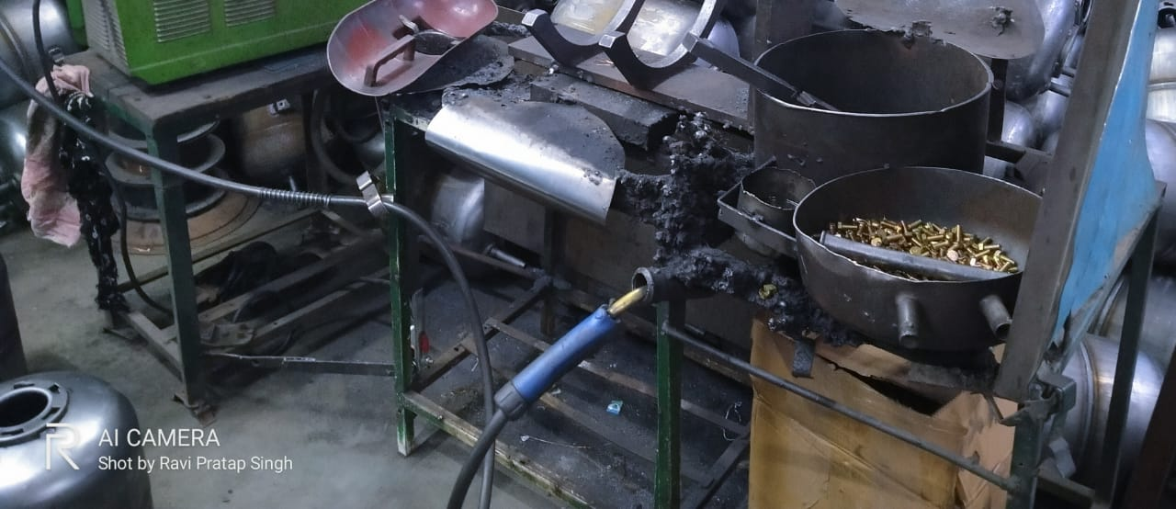
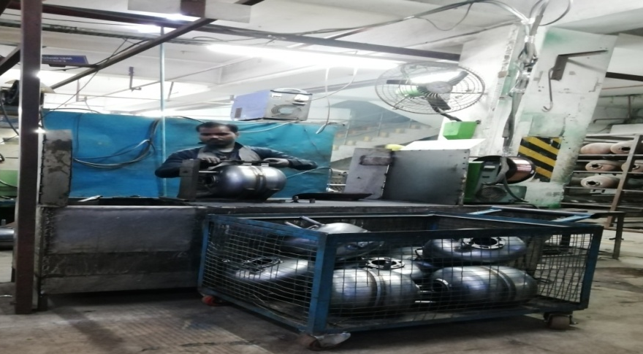
Kaizen
Dept./Section : Storage water heater/ D-316 Onkar
Process : Tank Fabrication
Date of implementation : 09-01-2020
Improvement categories (Tick the applicable one’s) :
(1) Quality imp.
(2) Manpower/Man hours
(3) Reduce 3M
(4) Space saving
(5) Time saving
(6) Energy Saving
(7) Tact
(8) Yield
(9) 5S
(10) Efficiency
(11) Material Saving
(12) Waste Reduction
(13) Packing
(14) Safety
(15) Others
Before
After
Very less & haphazard working station of Clamp Welding
Very neat & clean & proper work station of Clamp Welding
Benefits:
1- Very less chances of accident
2- Raw material properly stored at desired position
Prepared By:-
Reviewed By:-
Approved By:-

Slide 5
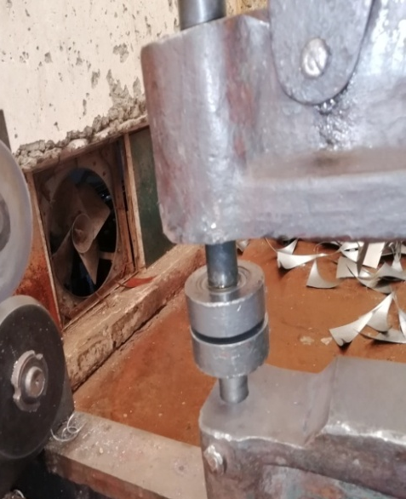
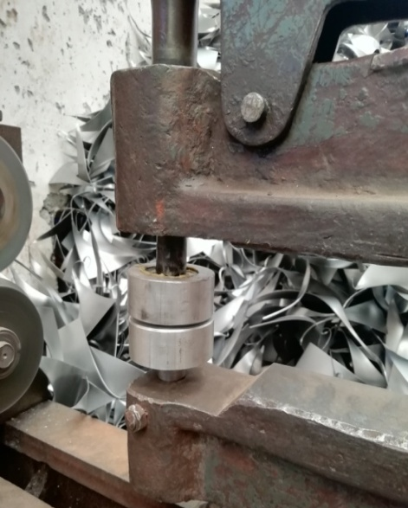
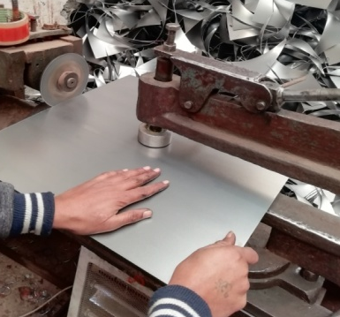
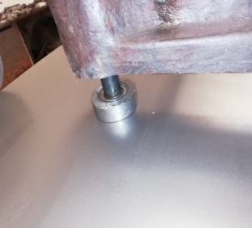
Kaizen
Dept./Section : Tank Fabrication/ D-255 Onkar
Process : Tank Fabrication
Date of implementation : 24-01-2020
Improvement categories (Tick the applicable one’s) :
(1) Quality imp.
(2) Manpower/Man hours
(3) Reduce 3M
(4) Space saving
(5) Time saving
(6) Energy Saving
(7) Tact
(8) Yield
(9) 5S
(10) Efficiency
(11) Material Saving
(12) Waste Reduction
(13) Packing
(14) Safety
(15) Others
Before
After
MS Stopper for circle cutting
Aluminum Stopper for circle cutting
Benefits:
1- Minimized Heavy dent at holding position
Prepared By:-
Reviewed By:-
Approved By:-

Slide 6
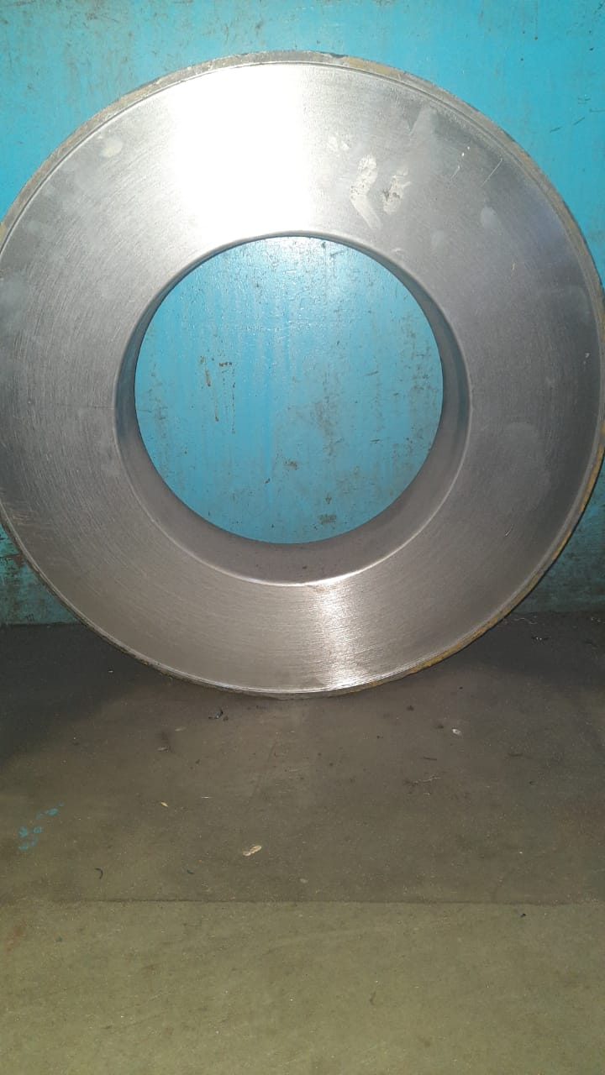
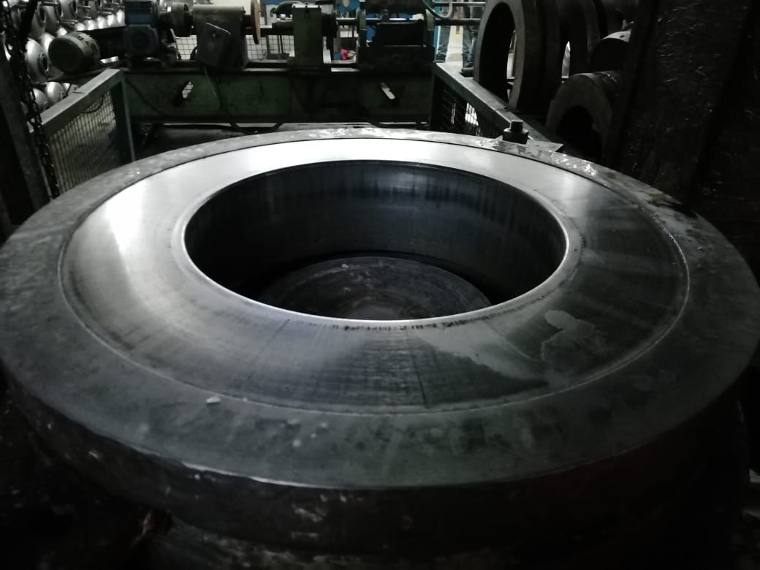
Kaizen
Dept./Section : Tank Fabrication/ D-255 Onkar
Process : Tank Fabrication
Date of implementation : 03-01-2020
Improvement categories (Tick the applicable one’s) :
(1) Quality imp.
(2) Manpower/Man hours
(3) Reduce 3M
(4) Space saving
(5) Time saving
(6) Energy Saving
(7) Tact
(8) Yield
(9) 5S
(10) Efficiency
(11) Material Saving
(12) Waste Reduction
(13) Packing
(14) Safety
(15) Others
Before
After
15 Amica Deep draw Die without slot to rest the circle
15 Amica Deep Draw die with slot to rest the circle
Benefits:
1- Uniform draw height.
Prepared By:-
Reviewed By:-
Approved By:-

